Slide 1
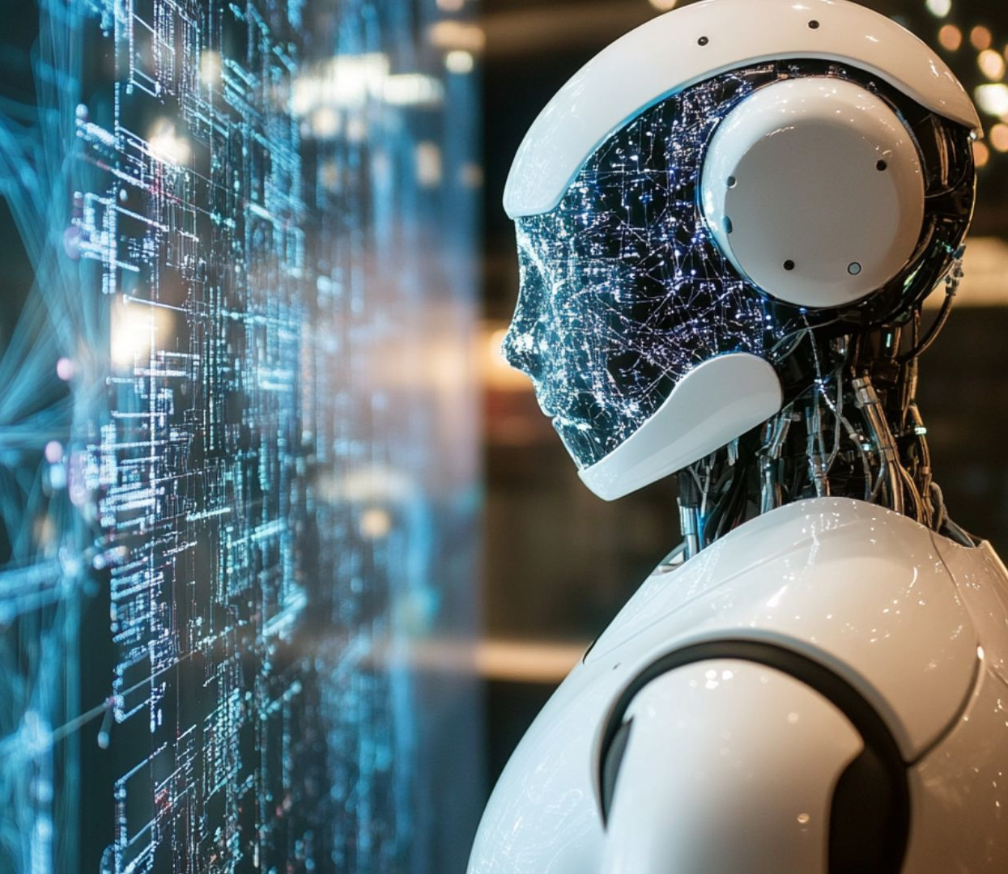
Introduction
AI-Powered Customer Engagement System for Artists (ArtConnect AI)
Client: Joe Fleishman
Team: Creative Intelligence Co. (CIC)
Members: Win Aung, Hoang Dinh, Kolapo Mogaji, Liqa Hasan Syed Mohammed Zaidi
Course: ITAI 4373 – The New Nature of Work in AI
Date: Nov 3 2025

Slide 2

Executive Summary
Goal: Help artist Joe Fleishman find and engage potential art buyers using AI—ethically and effectively.
Human-in-the-loop AI system for engagement & insights.
Combines analytics + creative decision-making.
Not automation or spam—ethical and transparent marketing.
Saves time, increases visibility, and maintains authenticity.

Slide 3
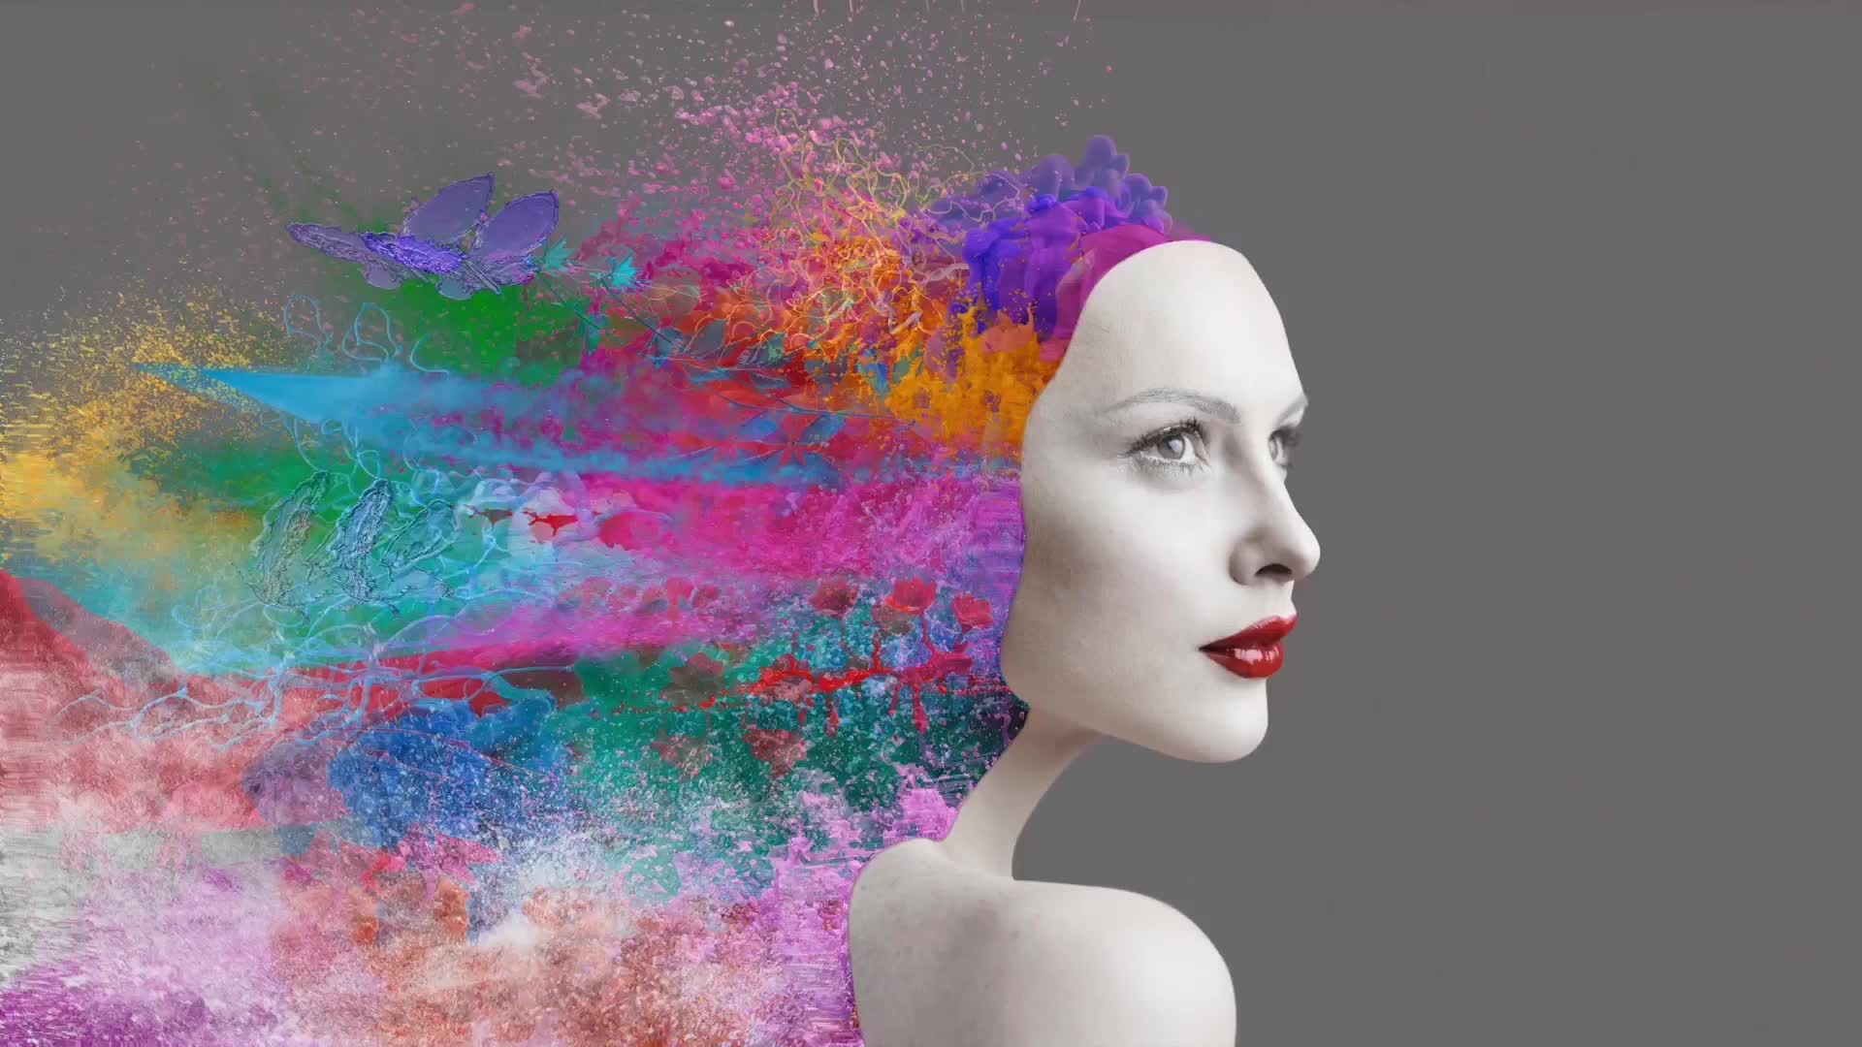
About the Artist
Joe Fleishman – Digital Painter & Illustrator
Known for expressive color and emotional digital portraits.
Blends fine art traditions with modern digital tools.
Promotes mainly on Instagram and online galleries. Challenges:
Limited reach & inconsistent engagement.
Hard to identify collectors.
Manual posting consumes creative time.

Slide 4

Target Audience Personas
1. The Art Collector (40–60 yrs)
Seeks prestige, investment pieces.
Platforms: Instagram, LinkedIn, Artsy.
2. The Home Décor Enthusiast (28–45 yrs)
Interior designers & homeowners.
Platforms: Pinterest, Instagram, Etsy.
3. The Digital Art Enthusiast (18–35 yrs)
NFT-curious, tech-driven art fans.
Platforms: Twitter (X), Discord, Behance.
AI segments these audiences for ethical, personalized outreach.

Slide 5

Platform & Market Insights
Platform | Use | AI Integration
Instagram | Visual storytelling | Smart timing, captions
Pinterest | Discovery | Visual trend analysis
LinkedIn | Networking | Lead generation
Etsy | E-commerce | Keyword optimization
Market Trends:
70%+ of art sales now online (Art Basel/UBS 2024).
Artists adopting AI analytics for marketing.
Consumers value authenticity and ethics.
Top Platforms for Joe:

Slide 6
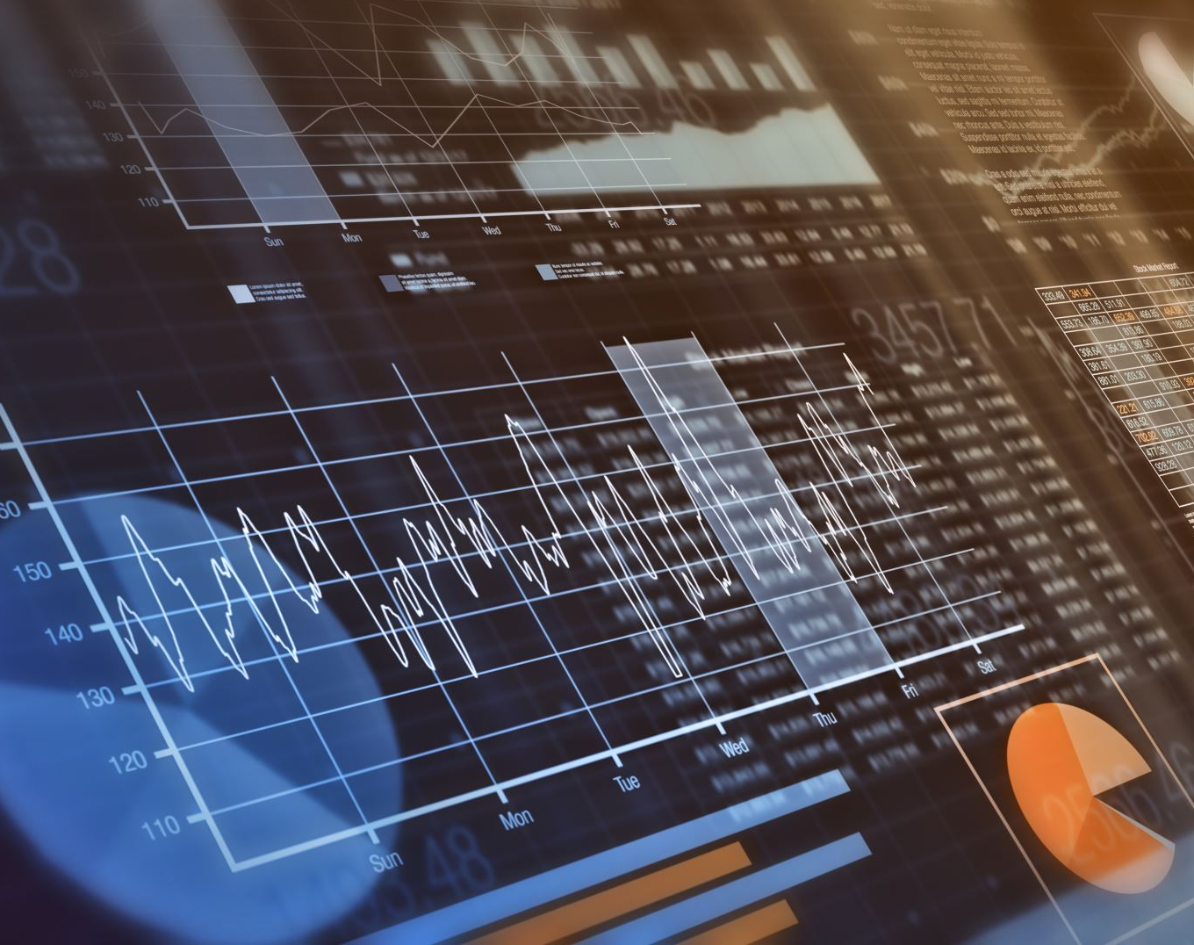
System Architecture
ArtConnect AI – How It Works:
Data Collection: Social media APIs, trend data.
AI Analytics: NLP + computer vision to find engagement patterns.
Recommendation Engine: Suggests captions, hashtags, leads.
Dashboard: Shows metrics, engagement heatmaps.
Human-in-the-Loop: Artist approves every AI output.
Tools: Python, GPT Models, Firebase, Power BI, React Dashboard.

Slide 7
AI & Prompt Engineering
AI Roles:
Analyst AI: Analyzes engagement data.
Advisor AI: Suggests captions & trends.
Assistant AI: Summarizes performance reports.
Prompt Example:
“You are an art marketing assistant helping a digital painter write a short, friendly caption for a new abstract portrait.”
Human-in-the-Loop:
Joe reviews & edits before publishing.
Transparent, ethical, AI-assisted creativity.

Slide 8
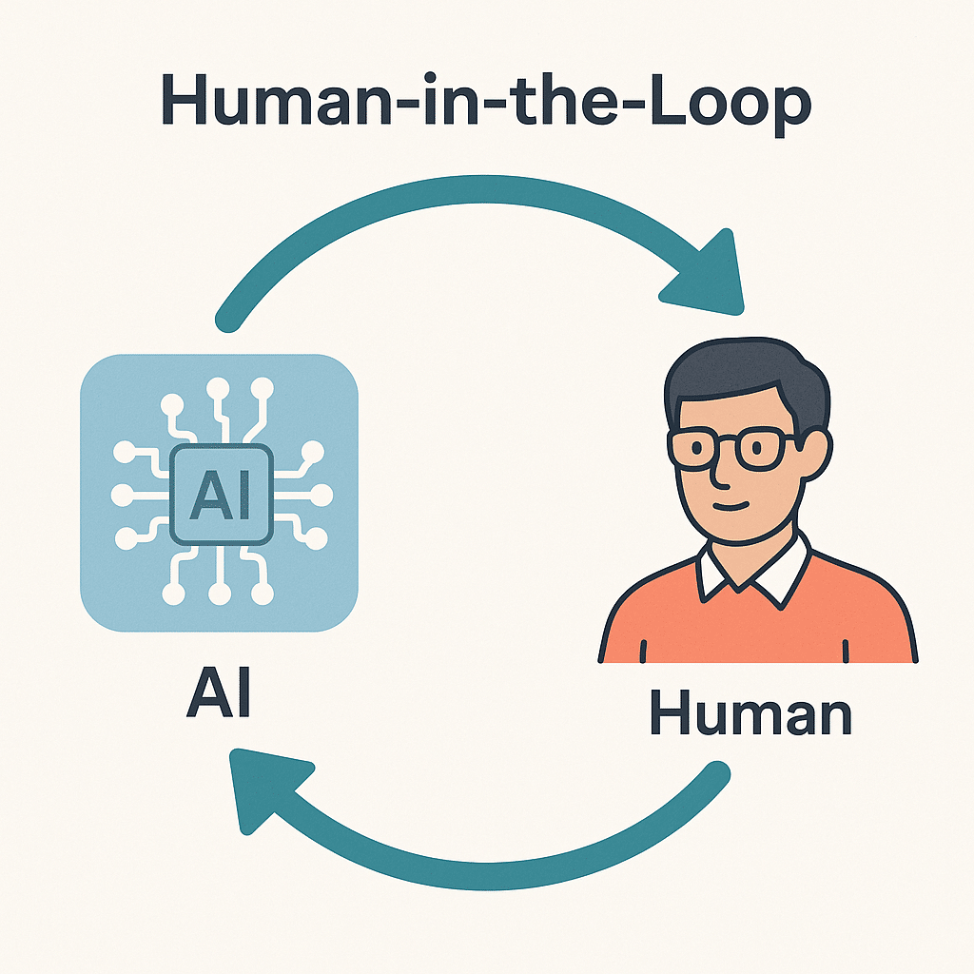
An Ethical AI Assistant
Core Concept: We are building you a filter, not a megaphone.
This is NOT:
A "spam bot"
An auto-reply or auto-DM tool
A system that violates Terms of Service
This IS:
A Human-in-the-Loop dashboard
A smart assistant that finds opportunities and suggests replies
A tool that gives you 100% final control

Slide 9
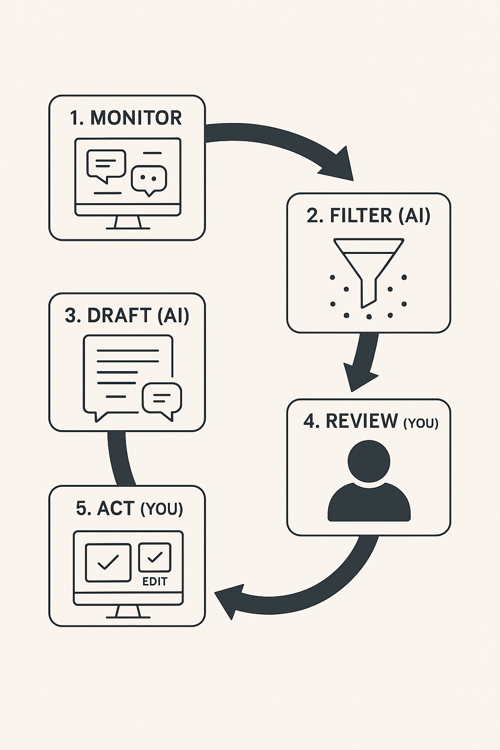
How It Works: You Are Always in Control
1. MONITOR: The system scans public posts on Reddit & X for keywords.
2. FILTER (AI): AI reads posts and filters out 99% of the noise, identifying real leads.
3. DRAFT (AI): AI drafts 2-3 "Sleek & Professional" replies for each lead.
4. REVIEW (YOU): Leads appear in your dashboard. You review the suggested drafts.
5. ACT (YOU): You click "Edit" or "Approve & Send." Nothing happens without you.

Slide 10

Ethics & Legal Compliance
Ethical Framework:
Transparency — AI outputs labeled “AI-assisted.”
Privacy — Only public engagement data used.
Authenticity — Human final approval always required.
Fairness — Bias checks and inclusive content.
Legal Compliance:
Follows platform Terms of Service.
GDPR / CCPA-aligned data protection.
Artist retains full ownership of content.

Slide 11
Financial Plan & ROI
Metric | Before | After | Growth
Monthly Engagement | 5,000 | 15,000 | +200%
Leads per Month | 10 | 40 | +300%
Monthly Sales | $2,000 | $6,500 | +225%
ROI: ~310%
Estimated Cost (6-month pilot): ≈ $16,000
AI services, cloud hosting, development, maintenance.
Projected ROI (Year 1):
Future Model: Subscription tiers for artists, galleries, and agencies.

Slide 12
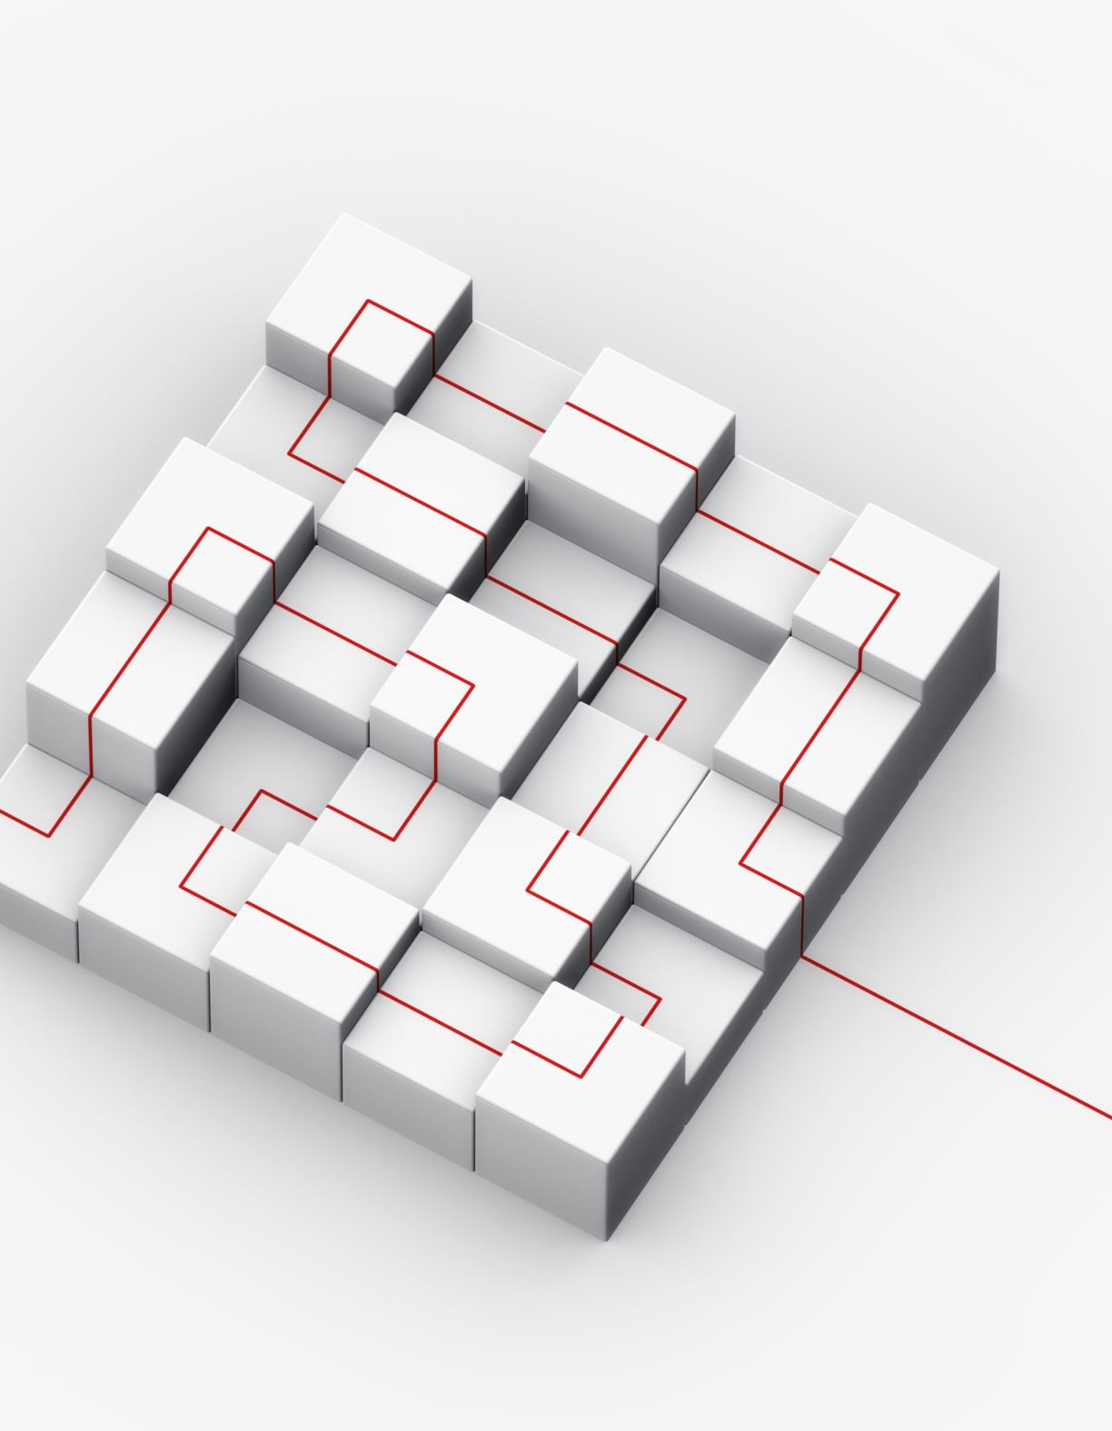
Project Timeline
10-Week Agile Plan:
Weeks 1–2 → Research & Market Analysis
Weeks 3–4 → Technical System Design
Weeks 5–6 → Prototype & Ethics Integration
Weeks 7–8 → ROI & Legal Review
Weeks 9–10 → Presentation & Delivery
Deliverables:
Full proposal PDF
PowerPoint Presentation
Client feedback session

Slide 13
Team Roles
Role | Key Duties
Project Manager | Oversees timeline & deliverables
AI Engineer | Builds model architecture & prompts
Data Analyst | Market insights & ROI calculations
Ethics Specialist | Ensures compliance & transparency
Designer/Presenter | Creates visuals & client presentation
Communication:
Weekly team meetings (Zoom/Teams).
Shared drive & Trello board for progress tracking.

Slide 14

Conclusion
Ethical + Innovative + Human-Centered AI System
Empowers Joe Fleishman to connect with new collectors.
Enhances visibility & creativity without losing authenticity.
Builds sustainable, ethical growth in the digital art market.
“AI should serve the artist — not replace the artist.”

